Slide 1




ITC 6008 Search engines and Web mining
Pavlos Gaitanis
Anastasios Karmas
Ilias Siafakas

Slide 2

The Goal of this project is to create an Information retrieval system in order to rank Reddit posts by their relevance to a query.

Slide 3
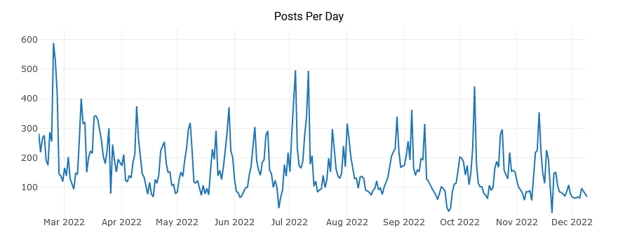
F1 Subreddit, r/formula1
Dedicated to Formula 1 racing.
In the top 1% of reddit subreddits by size.
2,7 million users
During the race weekend the sub sees more than
200 posts per day.

Slide 4
General Process
Used PRAW(Python Reddit API Wrapper) to retrieve posts. The library leverages the Reddit API and exposes it to Python built in functions.
Preprocessed the body and the title of each post retrieved.
Created three search engine variations based on Vector Space Modeling.
Vectorized the query in the same vector space as the documents and returned the highest scoring ones using cosine similarity between the document and query.
Notes:
Os edo tasos

Slide 5
PRAW Python Reddit API Wrapper
The PRAW library was used to gather posts from the formula 1 subreddit.
It creates an object that can be accessed and contains the data the Reddit API is making accessible.
It contains many items that are not pertinent to the project scope as it is designed for a wide variety of uses.

Slide 6
Preprocess
Collected the title and the bodies of 1000 post in the subreddit
Kept only posts that had both a title and a body
Put them in the same dataframe
Tokenized the merged list of the titles and their bodies
Removed stop words and punctuation.

Slide 7
TF-IDF
TF-IDF (Term Frequency-Inverse Document Frequency) is a common method used in natural language processing for quantifying the importance of a word in a document. It is typically used to improve the performance of search engines and other information retrieval systems.
The document corpus is vectorized with the TF-IDF vectorizer.
The query is also vectorized with the same method.
The dot product between the query vector and each document vector is calculated
The highest scoring documents are retrieved
Notes:
Os edo pavlos

Slide 8
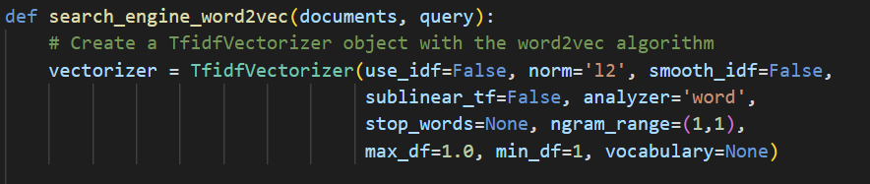
Word2Vec
Gensim's implementation of Word2Vec required a pre-trained model of considerable size to provide proper vectors to our dataset
Because of the narrow scope and use case of the project, no such dataset exists. Instead, we used the same TFIDF vectorizer but repurposed it to not require a pre-trained model and disabled all TF and IDF features of the vectorizer.
That resulted in vectors very close to what a normal Word2Vec vectorizer would achieve

Slide 9
TF-IDF with sentiment
The same process of assigning scores is used here
In addition to the scores each document and the query is assinged a sentiment/polarity score using the SentimentIntensityAnalyzer library
The abosulte distance between the score of the query and each document is calculated, and normalized to a value between 0-1
The two scores are added with the similarity score having a larger weight to the total score (80/20)

Slide 10
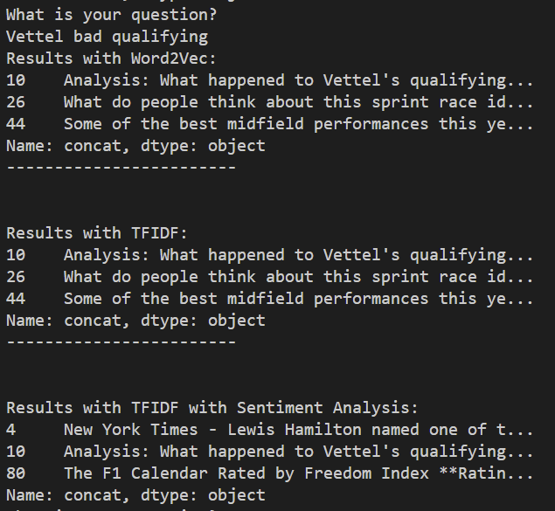
Results
Both Word2Vec and TFIDF return similar results from the search
TFIDF with Sentiment analysis also uses the sentiment score of each document so the results are different
TFIDF with sentiment shows correct results nonetheless since document #10 is present
Notes:
Os edo Ilias

Slide 11
Limitations
The API and its documentation is old so we cannot use it to retrieve posts between specific dates. E.g. posts about each race weekend.
Because of the novelty of this application, no previous dataset exists that can be used to train our models.
Retrieval of a large number of posts was quite slow.
Notes:
Kleisimo

Slide 12
Thank you for your time

